Slide 1
Task 1
Identifying categories of hate memes

Slide 2
Task 2 : Reasoning Of Meme Labelled Into Different Categories

Slide 3
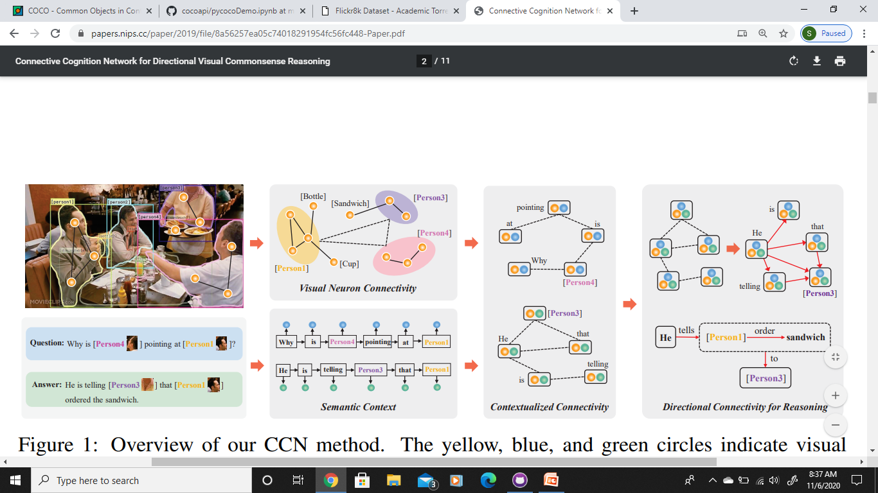
Connective Cognition Network for Directional Visual Commonsense Reasoning
https://papers.nips.cc/paper/2019/file/8a56257ea05c74018291954fc56fc448-Paper.pdf
Dataset : Visual Commonsense Reasoning
List of objects
A query
A set of N responses

Slide 4
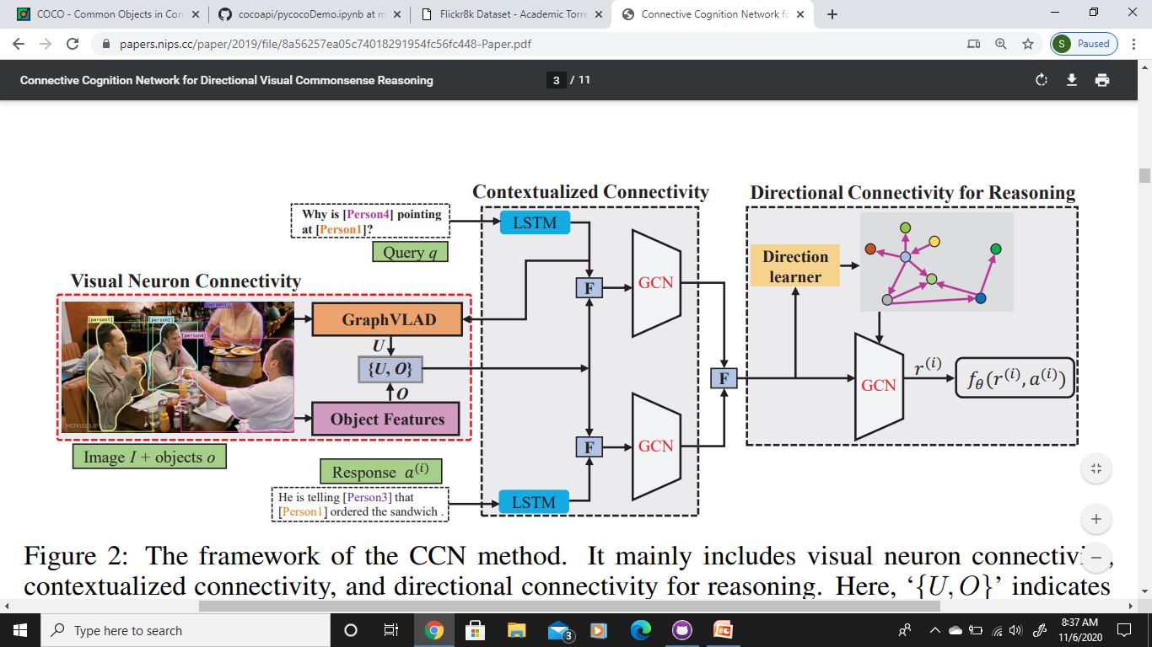

Slide 5
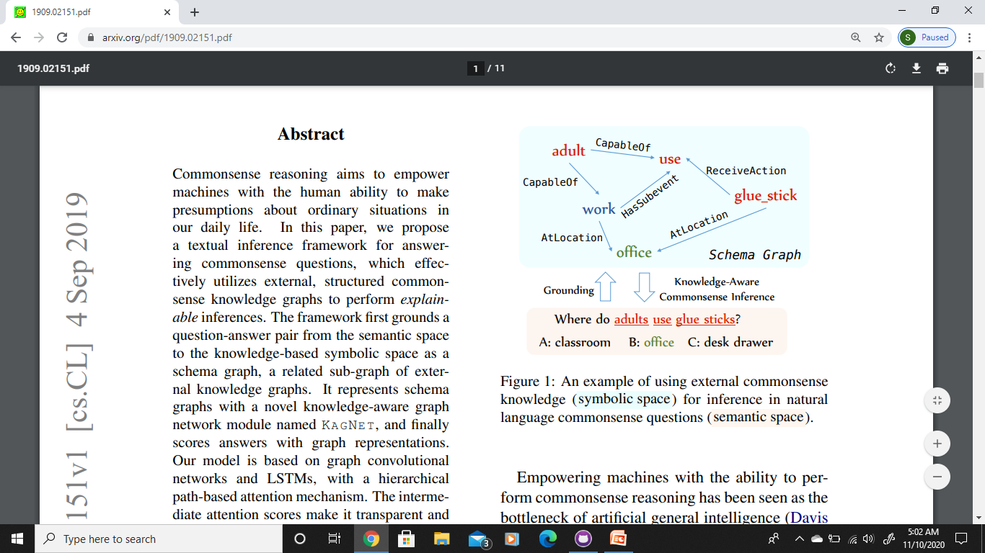
KagNet: Knowledge-Aware Graph Networks for Commonsense Reasoning
https://arxiv.org/abs/1909.02151

Slide 6
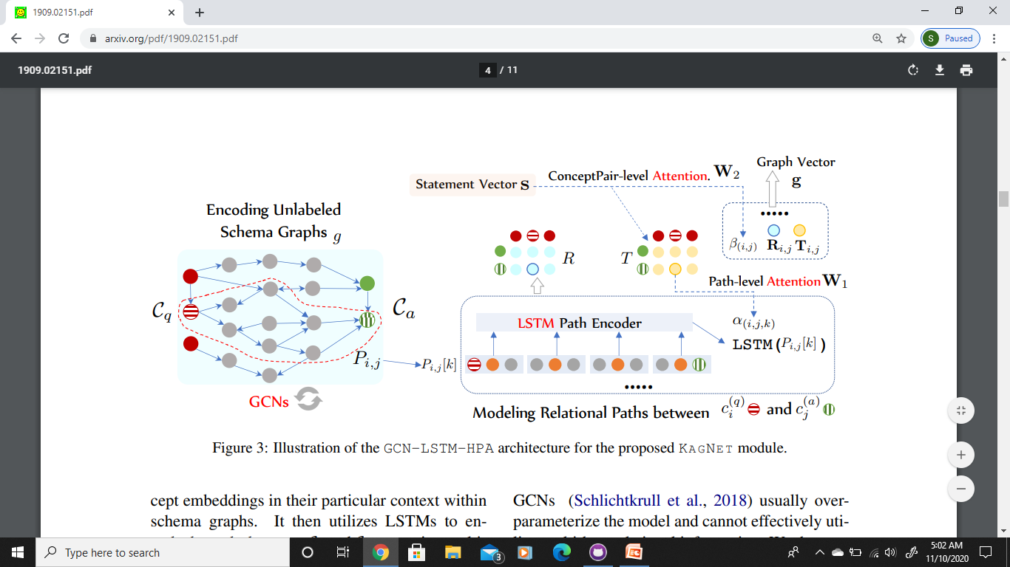

Slide 7
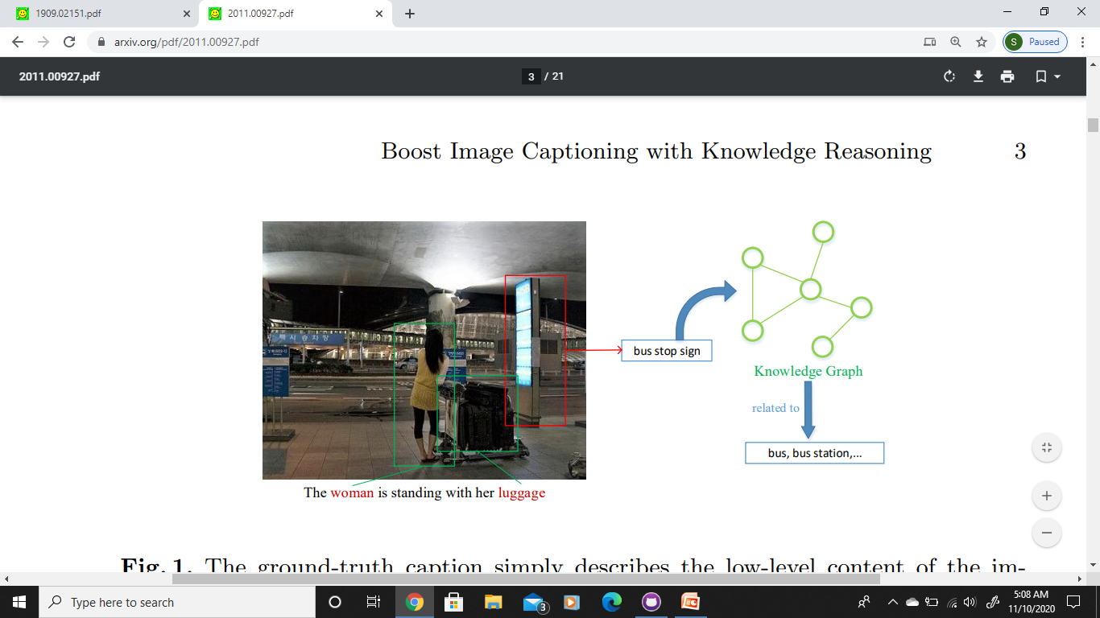
Boost Image Captioning with Knowledge Reasoning
https://arxiv.org/pdf/2011.00927.pdf

Slide 8
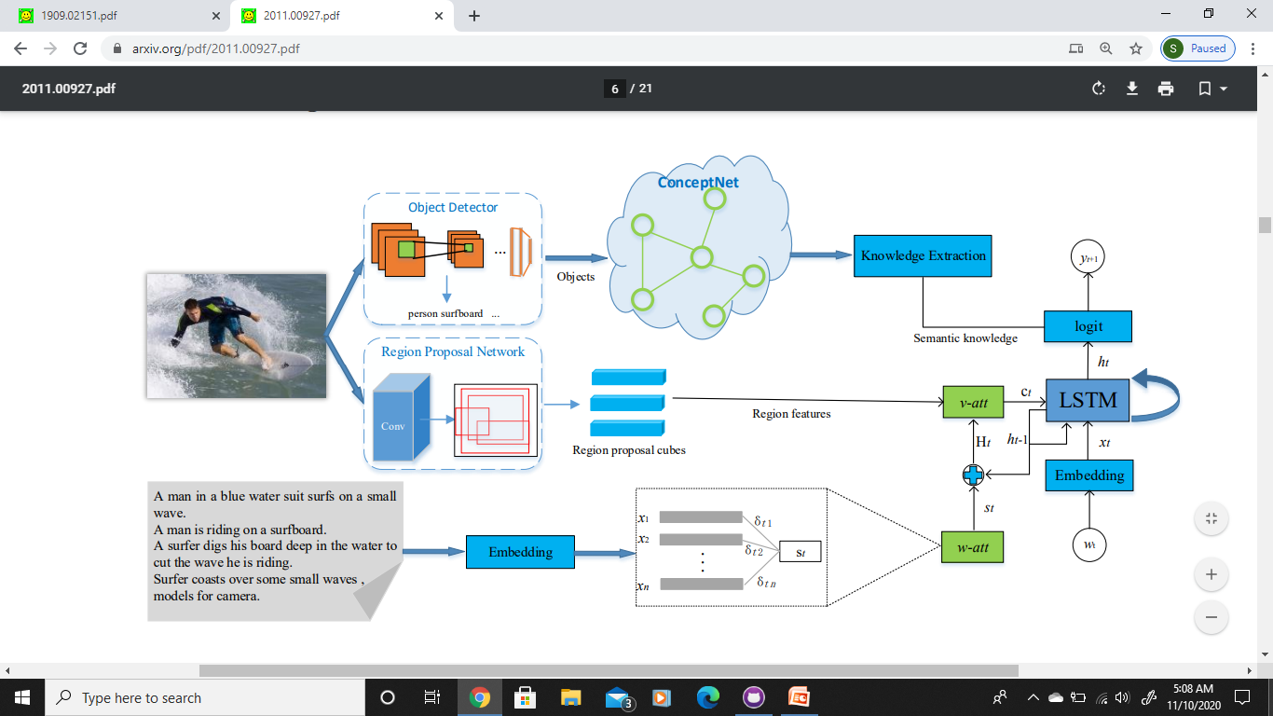

Slide 9
Proposed Methodology
IMAGE
CONTEXTUALIZED CONNECTIVITY
TEXT
REASONING
LANGUAGE GENERATION
REASON
LABEL

